Slide 1

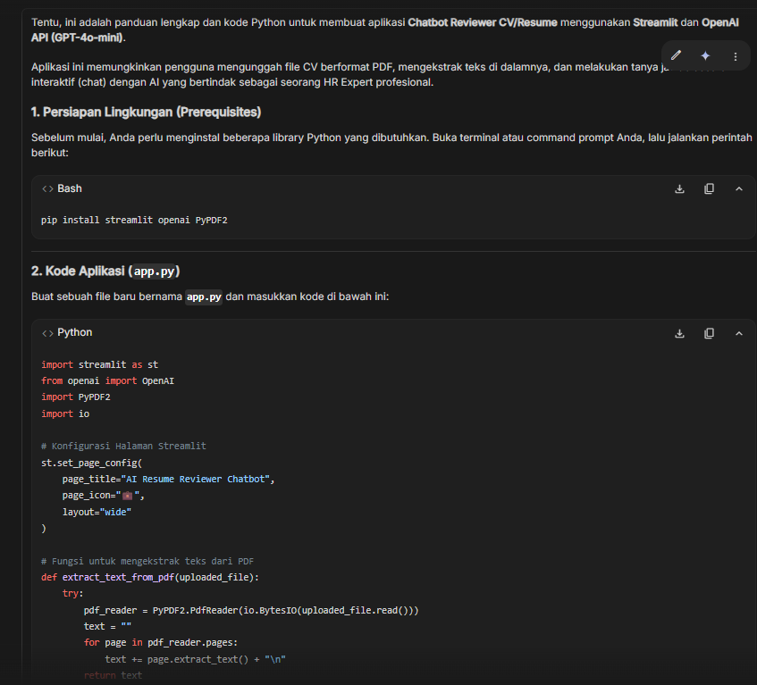
Prompt 1
Output dari Google AI Studio
Zero-shot prompt - Starting point tanpa detail
Temperature:
1
Top P:
0.95
Buatkan saya aplikasi chatbot untuk review resume/CV dengan streamlit
Slide 1
Notes:
1

Slide 2
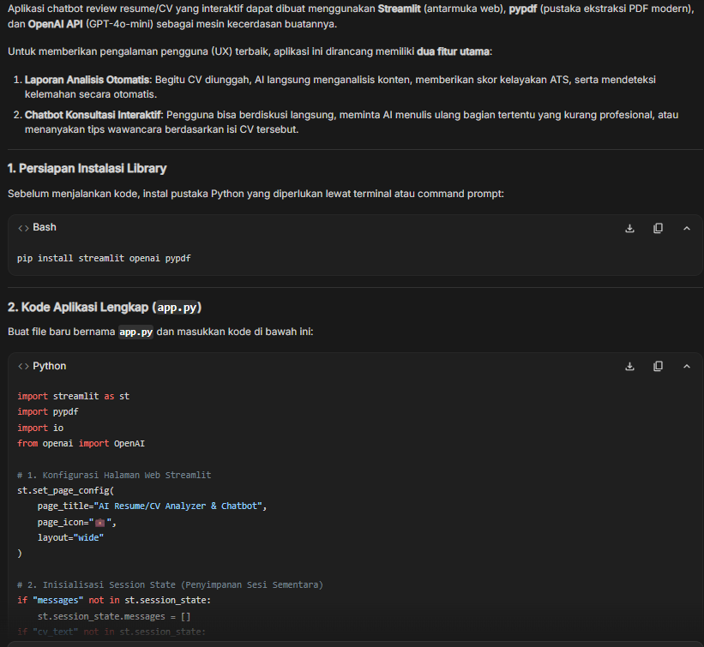
Prompt 2
Output dari Google AI Studio
Menambahkan requirement upload PDF
Temperature:
0.9
Top P:
0.95
Buatkan saya aplikasi chatbot untuk review resume/CV dengan streamlit. Aplikasi harus bisa upload file PDF dan menganalisis kontennya.
Slide 2
Notes:
2

Slide 3
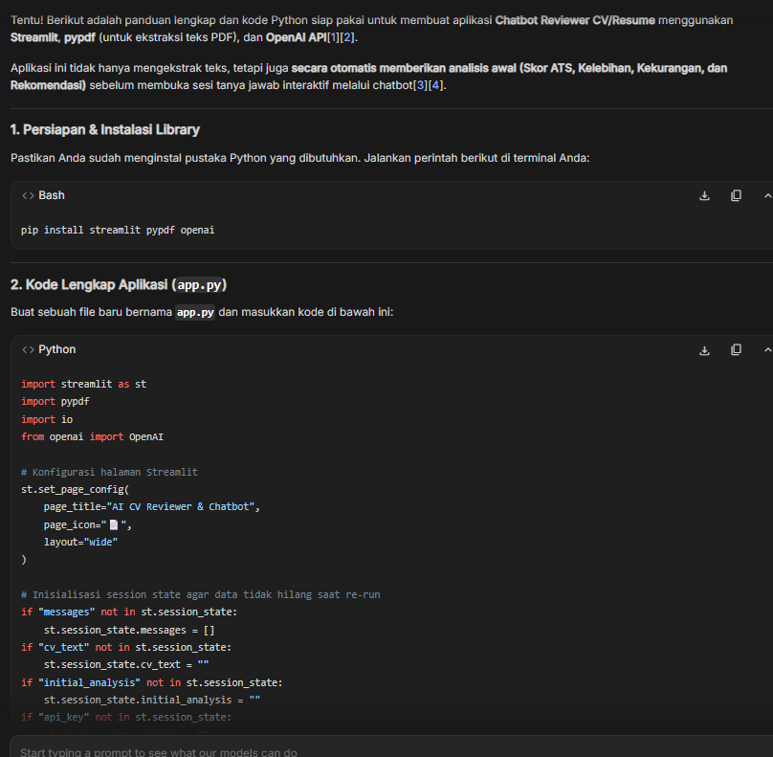
Prompt 3
Output dari Google AI Studio
Memecah requirement menjadi bullets
Temperature:
0.85
Top P:
0.9
Buatkan saya aplikasi chatbot untuk review resume/CV dengan streamlit. Aplikasi harus bisa:
- Upload file PDF
- Extract text dari PDF
- Analisis konten CV
Slide 3
Notes:
3

Slide 4
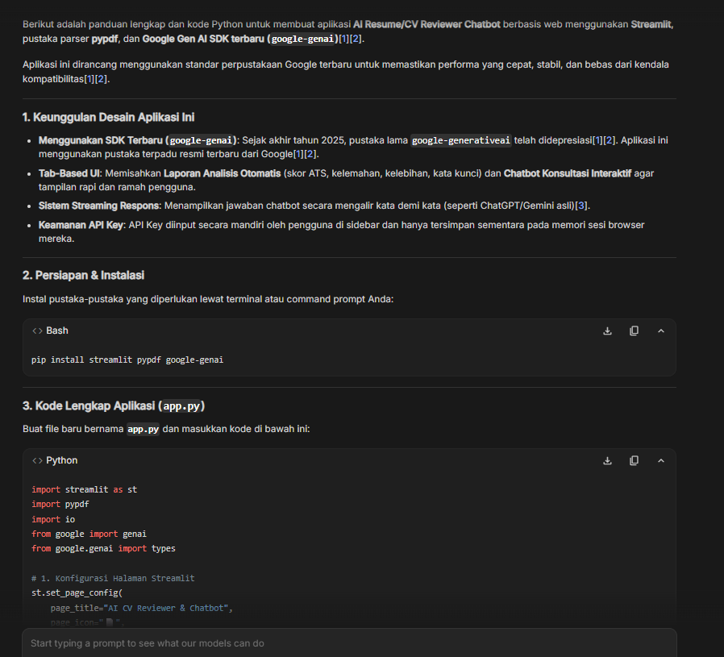
Prompt 4
Output dari Google AI Studio
Menambahkan tech stack (Gemini API)
Temperature:
0.8
Top P:
0.9
Buatkan saya aplikasi chatbot untuk review resume/CV dengan streamlit menggunakan Google Gemini API. Fitur:
- Upload file PDF
- Extract text dari PDF
- Analisis CV dengan AI
- Tampilkan hasil analisis
Slide 4
Notes:
4

Slide 5
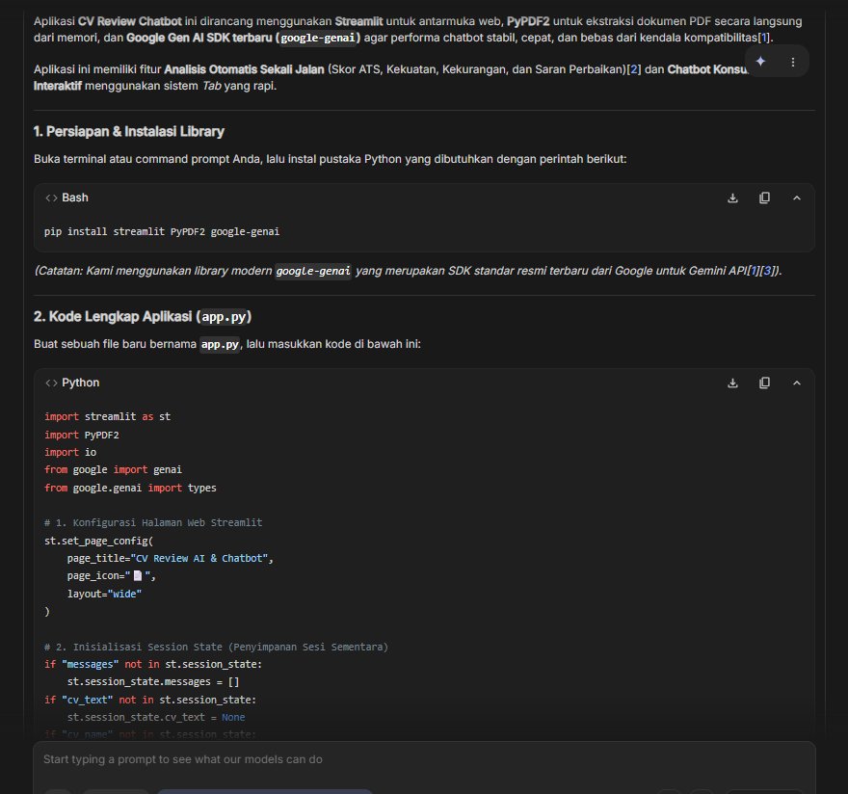
Prompt 5
Output dari Google AI Studio
Menambahkan struktur output yang diinginkan
Temperature:
0.75
Top P:
0.85
Buatkan aplikasi CV Review Chatbot dengan:
Tech Stack:
- Streamlit untuk UI
- Google Gemini API untuk AI
- PyPDF2 untuk extract PDF
Fitur:
1. Upload CV (PDF)
2. Extract teks otomatis
3. Analisis AI:
- Kekuatan CV
- Kekurangan CV
- Saran perbaikan
4. Output terstruktur
Slide 5
Notes:
5

Slide 6
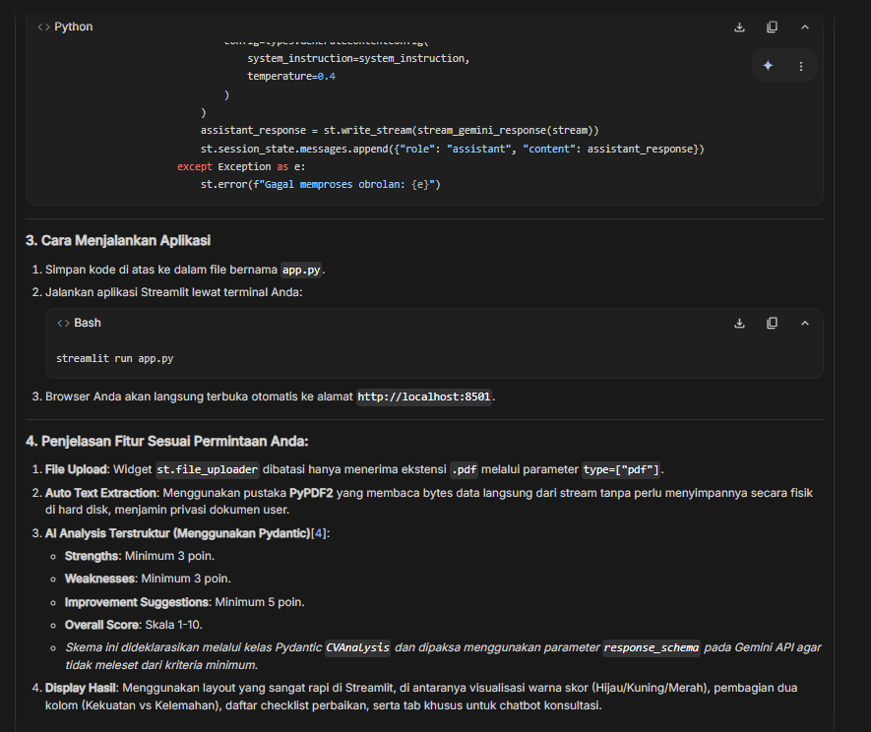
Prompt 6
Output dari Google AI Studio
Menambahkan spesifikasi output detail
Temperature:
0.7
Top P:
0.85
Buatkan aplikasi CV Review Chatbot dengan:
Tech Stack:
- Streamlit (UI framework)
- Google Gemini API (LLM)
- PyPDF2 (PDF parser)
Fitur Utama:
1. File Upload (accept .pdf only)
2. Auto text extraction
3. AI Analysis dengan output:
- Strengths (min 3 points)
- Weaknesses (min 3 points)
- Improvement suggestions (min 5 points)
- Overall score (1-10)
4. Display results in structured format
Slide 6
Notes:
6

Slide 7
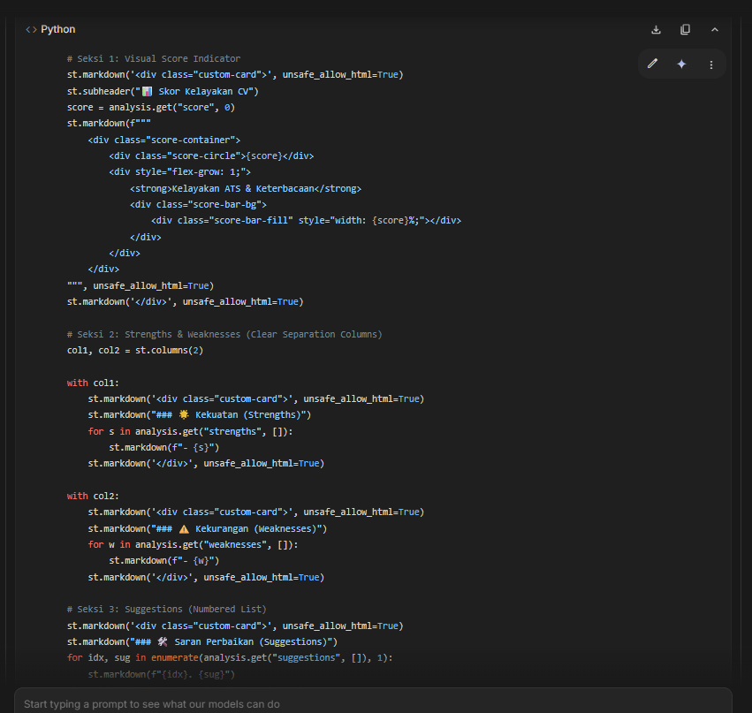
Prompt 7
Output dari Google AI Studio
Menambahkan UI requirements dan download feature
Temperature:
0.7
Top P:
0.8
Buatkan aplikasi CV Review Chatbot:
Tech Stack:
- Streamlit
- Google Gemini API (model: gemini-pro)
- PyPDF2
UI Requirements:
- Minimalist design
- Grey color scheme
- Clear section separation
Fitur:
1. PDF upload dengan validation
2. Extract text otomatis
3. AI analysis dengan Gemini
4. Structured output:
- Strengths (bullet points)
- Weaknesses (bullet points)
- Suggestions (numbered list)
- Score (visual indicator)
5. Download hasil analisis
Slide 7
Notes:
7

Slide 8
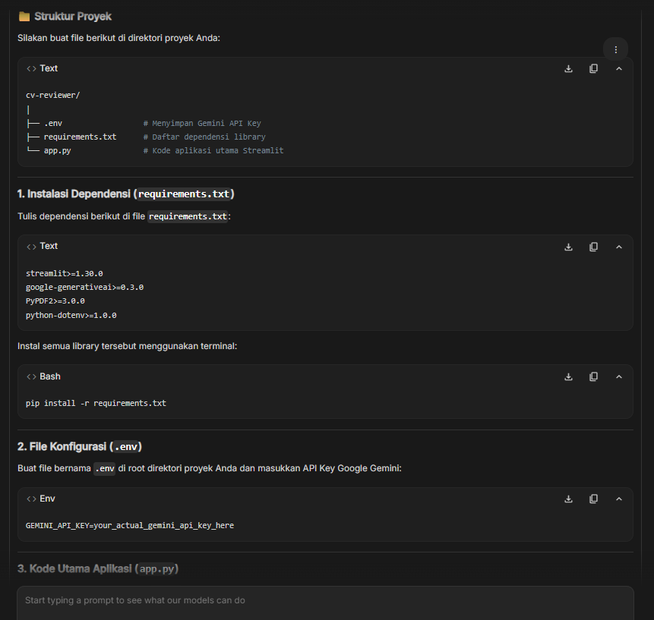
Prompt 8
Buatkan CV Review Chatbot dengan parameter berikut:
Tech Stack:
- Streamlit (latest version)
- Google Gemini API (gemini-pro)
- PyPDF2 untuk parsing
- python-dotenv untuk config
UI Design:
- Minimalist grey theme
- Responsive layout
- Progress indicators
- Error handling messages
Core Features:
1. Upload CV (PDF, max 5MB)
2. Text extraction dengan error handling
3. AI Analysis menggunakan prompt engineering:
"Analyze this CV for an AI Engineer position. Provide:
1. Top 3 strengths
2. Top 3 weaknesses
3. 5 specific improvement suggestions
4. Overall score (1-10) with justification"
4. Display formatted results
5. Download report (TXT format)
Menambahkan error handling dan prompt template untuk AI
Temperature:
0.65
Top P:
0.8
Slide 8
Notes:
8

Slide 9
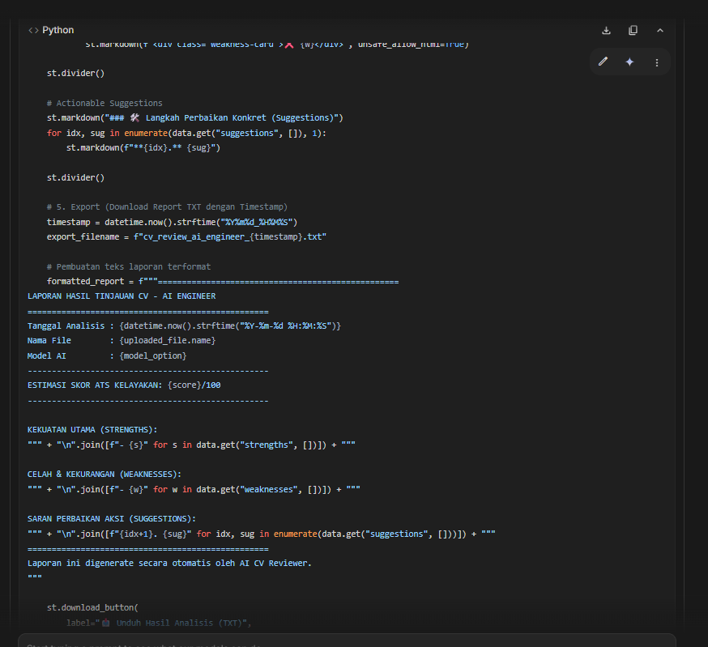
CV Review Chatbot - Full Specification:
Tech Stack:
- Streamlit 1.28+
- Google Gemini API (gemini-pro)
- PyPDF2 2.0+
- python-dotenv
UI Components:
- Header with app title and description
- Sidebar untuk settings:
* API key input (masked)
* Model selection
- Main area:
* File uploader
* Analysis button
* Results container
- Footer dengan credits
Features:
1. PDF Upload
- File size validation (max 5MB)
- PDF format validation
- Preview uploaded filename
2. Text Extraction
- Multi-page support
- Character encoding handling
- Empty content detection
3. AI Analysis
- Position-specific analysis (AI Engineer)
- Structured prompt template
- Response parsing
4. Results Display
- Strengths section (green highlights)
- Weaknesses section (red highlights)
- Suggestions (numbered, actionable)
- Score with visual progress bar
5. Export
- Download as formatted text
- Timestamp in filename
Prompt 9
Full specification dengan semua komponen detail
Temperature:
0.6
Top P:
0.75
Output dari Google AI Studio
Slide 9
Notes:
9

Slide 10
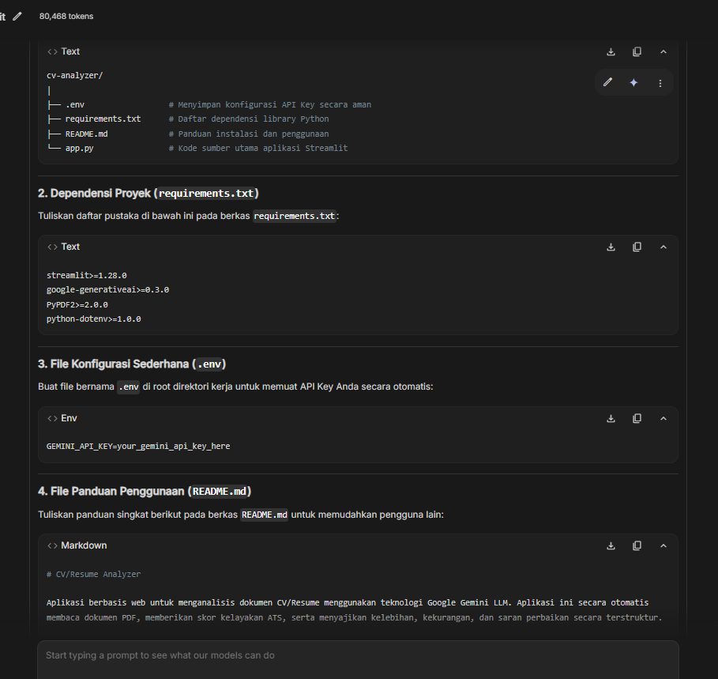
Prompt 10
CV Review Chatbot - Implementation Guide:
Project Structure:
```
app.py (main application)
requirements.txt
.env (API key)
README.md
``
app.py Components:
1. Imports & Config
```python
import streamlit as st
import google.generativeai as genai
from PyPDF2 import PdfReader
import os
from datetime import datetime
```
2. Page Config
- Title: "CV/Resume Analyzer"
- Icon: 📄
- Layout: wide
- Theme: grey minimal
3. Helper Functions:
- extract_text_from_pdf(file)
- analyze_cv_with_gemini(text, api_key)
- format_results(response)
- generate_download_link(content)
4. Main Flow:
a) Display header
b) Sidebar: API key + settings
c) File upload widget
d) If file uploaded:
- Extract text
- Show preview (first 200 chars)
- Analyze button
- Display results
- Download button
5. Error Handling:
- Invalid API key
- Upload errors
- Extraction failures
- API rate limits
6. Styling:
- Custom CSS untuk grey theme
- Card-based layout
- Smooth transitions
Panduan implementasi dengan struktur kode
Temperature:
0.6
Top P:
0.75
Output dari Google AI Studio
Slide 10
Notes:
10

Slide 11
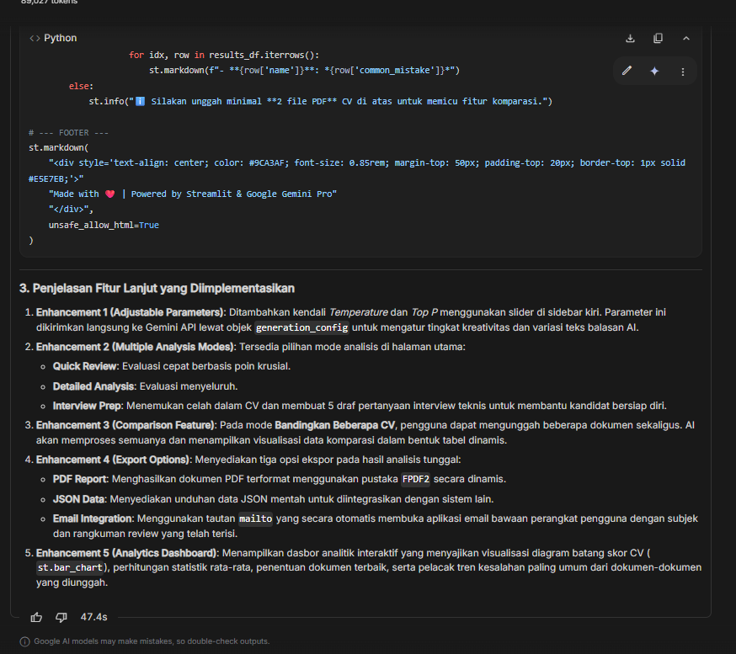
Prompt 11
CV Review Chatbot - Advanced Features:
Enhancement 1: Adjustable Parameters
```python
# Sidebar controls
st.sidebar.header("AI Settings")
temperature = st.sidebar.slider(
"Temperature", 0.0, 2.0, 1.0, 0.1
)
top_p = st.sidebar.slider(
"Top P", 0.0, 1.0, 0.95, 0.05
)
# Pass to Gemini
generation_config = {
"temperature": temperature,
"top_p": top_p,
"max_output_tokens": 2048,
}
```
Enhancement 2: Multiple Analysis Modes
- Quick Review (fast, basic feedback)
- Detailed Analysis (comprehensive)
- Interview Prep (focus on gaps)
Enhancement 3: Comparison Feature
- Upload multiple CVs
- Side-by-side comparison
- Best practices highlight
Enhancement 4: Export Options
- PDF report
- JSON data
- Email integration
Enhancement 5: Analytics Dashboard
- Common mistakes frequency
- Score distribution
- Improvement tracking
Menambahkan advanced features seperti adjustable parameters
Temperature:
0.5
Top P:
0.7
Output dari Google AI Studio
Notes:
12

Slide 12
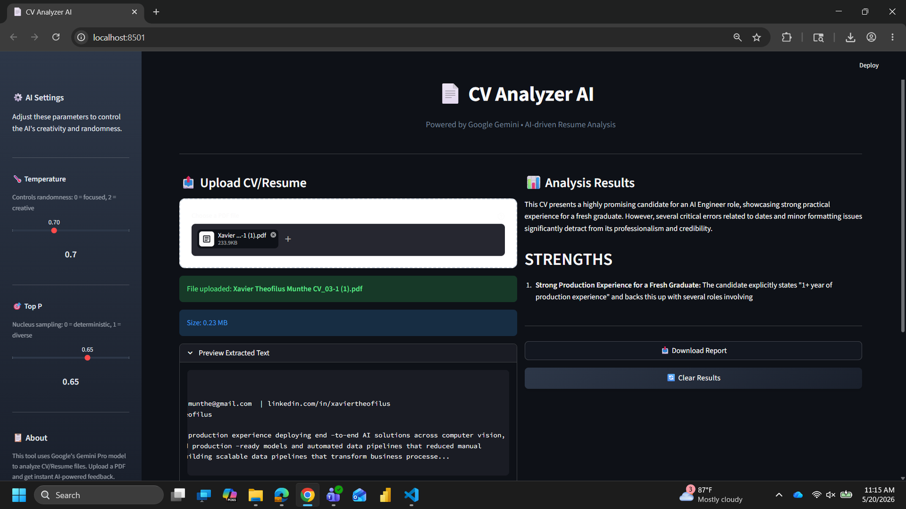
Final Output
Slide 13
Notes:
13

